Slide 1
Cloud Armor
Google Cloud Armor helps you protect your Google Cloud deployments from multiple types of threats, including distributed denial-of-service (DDoS) attacks and application attacks like cross-site scripting (XSS) and SQL injection (SQLi).
Can use security policies to protect applications running behind a load balancer from distributed denial-of-service (DDoS) and other web-based attacks, whether the applications are deployed on Google Cloud, in a hybrid deployment, or in a multi-cloud architecture.
Google Cloud Armor provides always-on DDoS protection against network or protocol-based volumetric DDoS attacks. This protection is for applications or services behind load balancers.
It is able to detect and mitigate network attacks in order to allow only well-formed requests through the load balancing proxies.

Slide 2
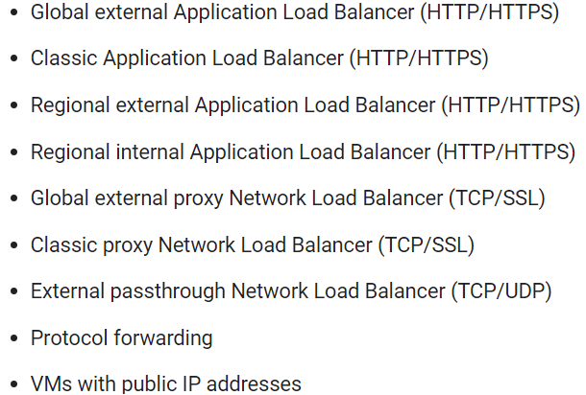
Security Policy
Google Cloud Armor security policies protect your application by providing Layer 7 filtering and by scrubbing incoming requests for common web attacks or other Layer 7 attributes to potentially block traffic before it reaches your load-balanced backend services or backend buckets.
Each security policy is made up of a set of rules that filter traffic based on conditions such as an incoming request's IP address, IP range, region code, or request headers.
When an incoming request matches a condition in a security policy rule, Google Cloud Armor allows, denies, or redirects the request, based on whether the rule is an allow rule, a deny rule, or a redirect rule.

Slide 3
Backend security policies
They can be used to filter requests and protect backend services that reference instance groups or network endpoint groups (NEGs) including Internet, Zonal, Hybrid, and Serverless NEGs. Not all load balancers support all types of NEG.
Backend security policies are used with backend services exposed by the following load balancer types:
Global external Application Load Balancer
Classic Application Load Balancer
Regional external Application Load Balancer
Regional internal Application Load Balancer
Global external proxy Network Load Balancer
Classic proxy Network Load Balancer

Slide 4
Edge security policies
Edge security policies enable users to configure filtering and access control policies for content that is stored in cache; this includes endpoints like Cloud CDN-enabled backend services and Cloud Storage buckets.
Edge security policies can coexist with backend security policies to provide two layers of protection.
When edge security policies and backend security policies are attached to the same backend service, backend security policies are enforced only for cache miss requests that have passed edge security policies.
Only edge security policies can be applied to backend buckets.
Edge security policies are supported for the following endpoints:
Global external Application Load Balancer
Classic Application Load Balancer

Slide 5
Network Edge security policies
Network edge security policies let you configure rules to block traffic at the edge of Google's network.
Enforcing network edge security policies does not consume VM or host resources, which helps prevent high volume traffic from exhausting resources on the target workload or otherwise causing a denial of service.
You can configure network edge security policies for the following resources:
External passthrough Network Load Balancers
Protocol forwarding
VMs with public IP addresses

Slide 6
Rule Evaluation Order
Rule evaluation order is determined by rule priority, from the lowest number to the highest number.
The rule with the lowest numeric value assigned has the highest logical priority and is evaluated prior to rules with lower logical priorities.
The minimum numeric priority is 0.
The priority for each rule must be set to a number from 0 to 2147483646 inclusive.

Slide 7
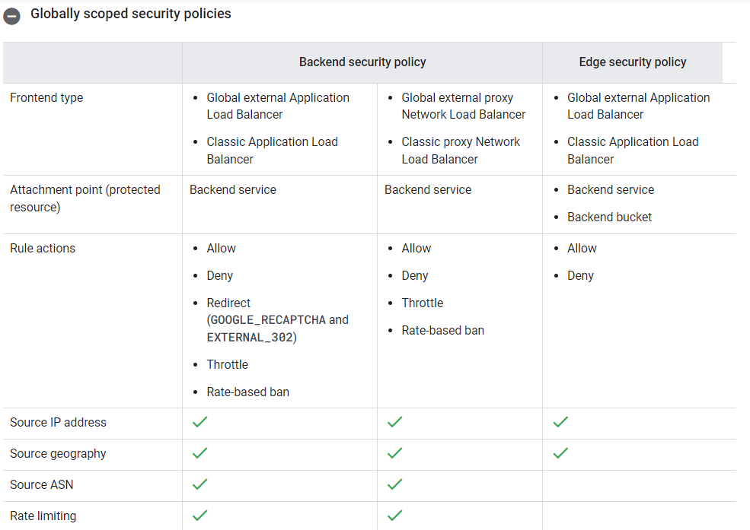
Globally Scoped Policy

Slide 8
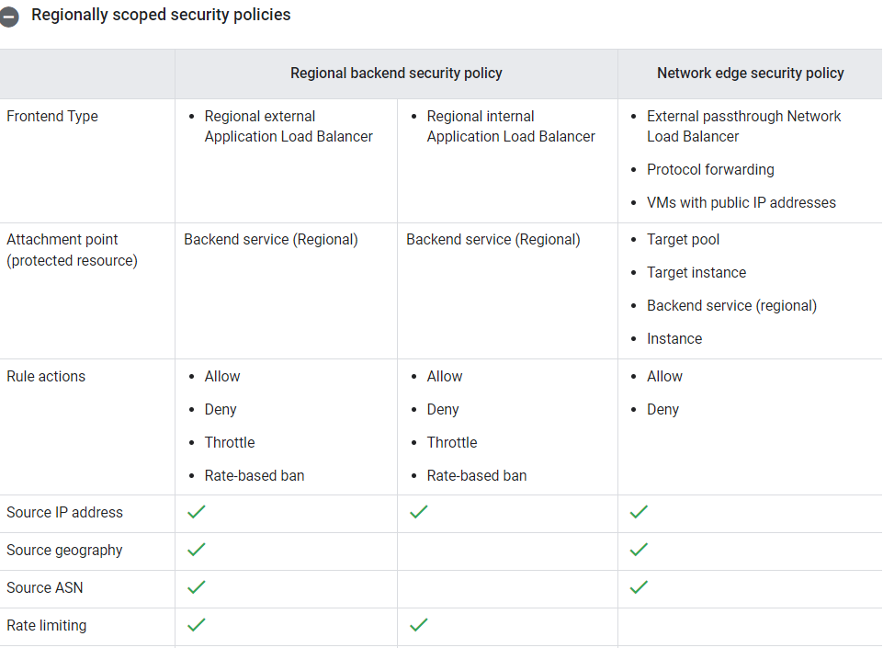
Regional Scoped Policy

